Slide 1
Ames, Iowa
Knowing the city plays an important role as the type of people, crimes, history of the city influences the type of people willing to move to the city and eventually the prices of the house.
It is a historic city with:
Low crime rate
Educated people
Low cost of living

Slide 2
Crime facts of Ames, Iowa
The overall crime rate in Ames is 37% lower than the national average
For every 100,000 people, there are 4.89 crimes that occur daily in Ames
Ames is safer than 61% cities in USA
In Ames, there is 1 in 57 chance of becoming victim of any crime
The number of total year over year crime in Ames has decreased by 13%

Slide 3
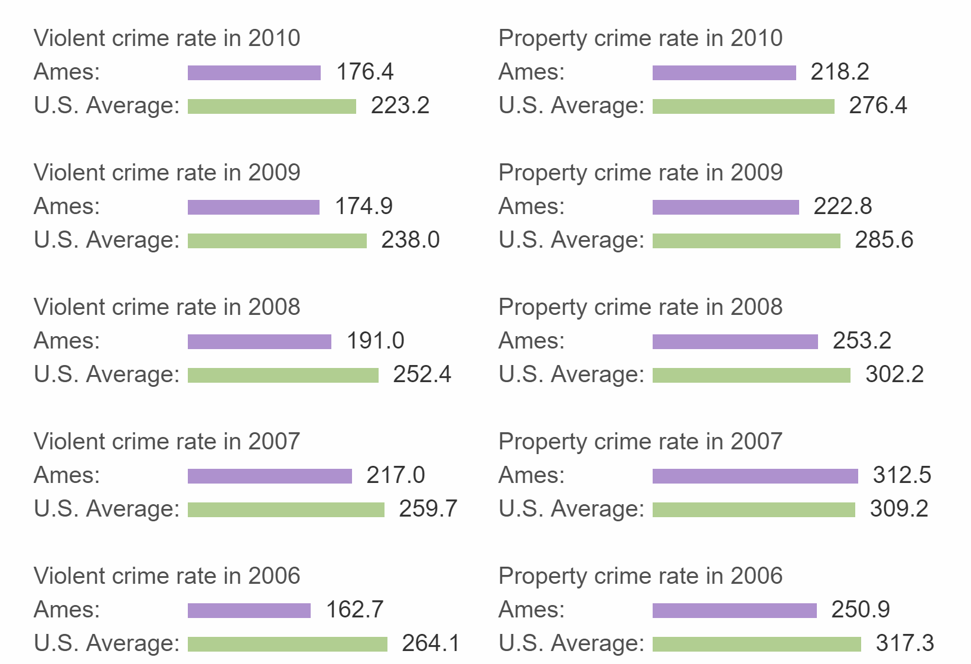
Various crimes and their rate in Ames compared to The United States average

Slide 4
Income and real estate facts in Ames, Iowa
Income per capita in Ames is 21% lower than that in Iowa
Median household income in Ames is 25% lower than national average
Male median earnings are 41% higher than female median earnings in Ames
Unemployment rate in Ames is 16% lower than the national average
Poverty level in Ames is 99% higher than the national average

Slide 5
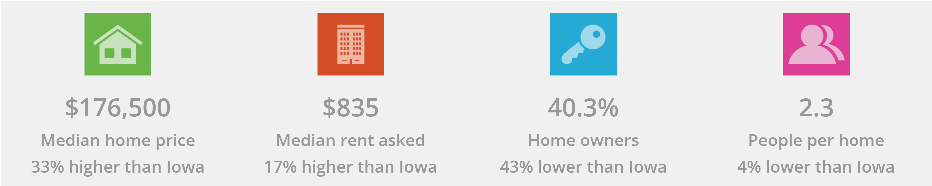
Real estate facts of Ames

Slide 6
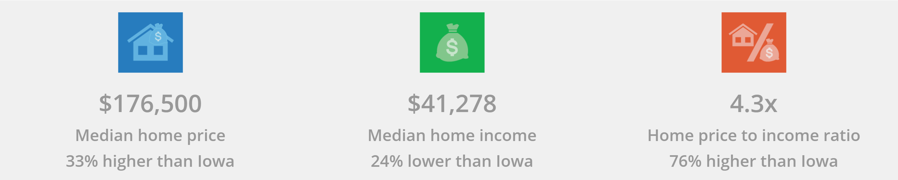
Home Affordability in Ames

Slide 7
Weather facts in Ames, Iowa
Highest monthly average temperature in Ames for July is 73 degrees
Highest monthly average temperature in Ames for January is 21 degrees
Most monthly precipitation in Ames occur in May with 5.5 inches
Air quality in Ames is 25% better than national average
Pollution index in Ames is 76% better than the national average

